Slide 1
Week-9
COSC 32001 Computer Vision
Noopa Jagadeesh
Date: 7 March 2024

Slide 2
Recap
Motion Detection
Frame Differencing
Optical Flow
Background Subtraction
Hough transform
Line Detection
Circle Detection

Slide 3
Agenda
Image Gradients
Corner Detection
Optical Character Recognition(OCR)
Simple Shape Detection
Face detection

Slide 4
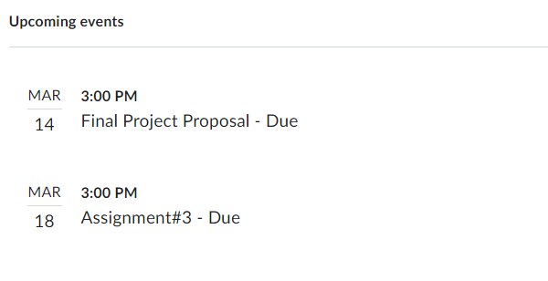
Critical Path

Slide 5
Image Gradients

Slide 6
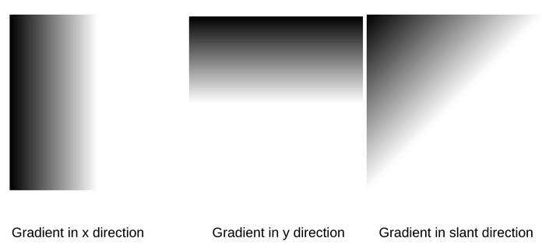
Image Gradients
An image gradient is a directional change in the intensity or color in an image.
The gradient of the image is one of the fundamental building blocks in image processing.
The gradient can be defined as the change in the direction of the intensity level of an image.
So, the gradient helps us measure how the image changes and based on sharp changes in the intensity levels; it detects the presence of an edge.

Slide 7
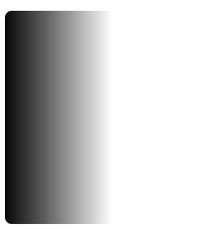

Image Gradients
Image gradient is used to extract information from an image. It is one of the fundamental building blocks in image processing and edge detection. The main application of image gradient is in edge detection. Many algorithms, such as Canny Edge Detection, use image gradients for detecting edges.
In this image there is a change in intensity levels only in the horizontal direction and no change in the y direction.
Here we can see that there is no change in the horizontal direction of the image.

Slide 8
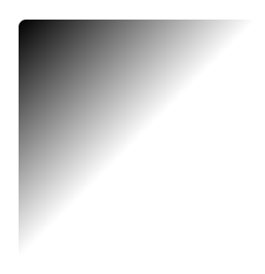

Image Gradients
Here there is a change in the intensity level in both the direction of the image.
Gradients have
Gradient magnitude
Gradient orientation
Gradient magnitude represents the strength of the change in the intensity level of the image.
The higher the Gradient magnitude, the stronger the change in the image intensity.

Slide 9
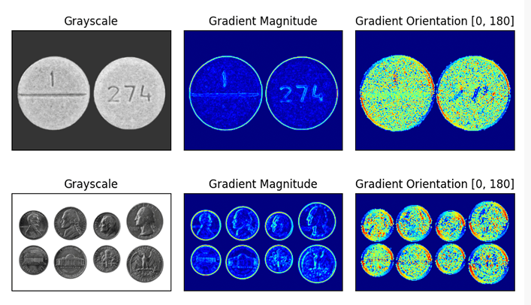
Image Gradients
Gradient Orientation represents the direction of the change of intensity levels in the image. We can find out gradient orientation by the formula given below:
Image gradients are a fundamental building block of many computer vision and image processing routines.
We use gradients for detecting edges in images, which allows us to find contours and outlines of objects in images
We use them as inputs for quantifying images through feature extraction — in fact, highly successful and well-known image descriptors such as Histogram of Oriented Gradients and SIFT are built upon image gradient representations
Gradient images are even used to construct saliency maps, which highlight the subjects of an image
However, image gradients are not often discussed in detail since other, more powerful and interesting methods are build on top of them.

Slide 10
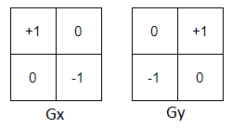
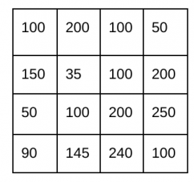
Image Gradients
Different filters or kernels can be used for finding gradients, i.e., detecting edges.
3 filters that are commonly used are:
Roberts filter
Prewitt filter
Sobel filter
Roberts Filter
Roberts filter is a 2 * 2 filter. It is one of the oldest and simplest filters. The idea behind the Roberts cross operator is to approximate the gradient of an image through discrete differentiation, computed by summing the squares of the differences between diagonally adjacent pixels.
Suppose we have this 4*4 image

Slide 11
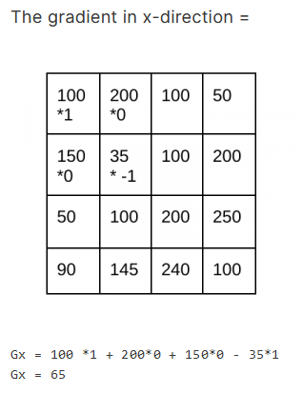
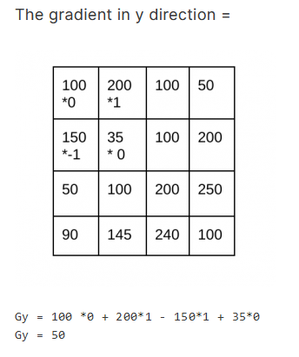
Image Gradients
Roberts filter
4*4 image

Slide 12


Image Gradients

Slide 13
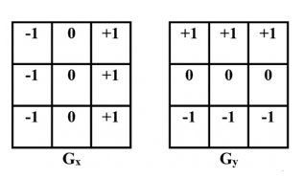
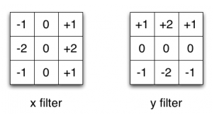
Image Gradients
Prewitt Filter
Prewitt filter is a 3 * 3 filter and it is more sensitive to vertical and horizontal edges as compared to the Sobel filter. It detects two types of edges – vertical and horizontal. Edges are calculated by using the difference between corresponding pixel intensities of an image.
Sobel Filter
Sobel filter is the same as the Prewitt filter, and just the center 2 values are changed from 1 to 2 and -1 to -2 in both the filters used for horizontal and vertical edge detection.

Slide 14
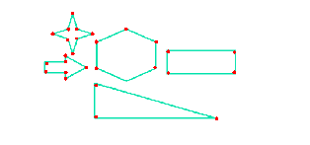
Corner Detection

Slide 15
Corner Detection
Corners are basically the intersection of two edges.
One of the most popular methods for corner detection is the Harris Corner Detection algorithm.
Shi-Tomasi is another one of the algorithms for Corner Detection.
Steps:
1. Convert Image to Grayscale
2. Convert to Float
The Harris Corner Detection function in OpenCV requires the image to be in float32 format. So, we will convert our grayscale image to float32 using the np.float32() function.
3. Apply Harris Corner Detection
Use the cornerHarris() function in OpenCV. This function takes in the grayscale image, the size of the neighborhood considered for corner detection (blockSize), the aperture parameter for the Sobel operator (ksize), and the Harris detector free parameter (k).
4. Dilate to Mark the Corners
To mark the corners in the image, we can dilate the image. Dilation expands the shapes found in the image, making the corner points more apparent.
5. Threshold for an Optimal Value
Next, we threshold the image to find the significant corners. For example we can say threshold as 1% of the maximum value in the image obtained after applying the Harris Corner Detection.

Slide 16
Optical Character Recognition(OCR)
Notes:
easyocr==1.6.2

Slide 17

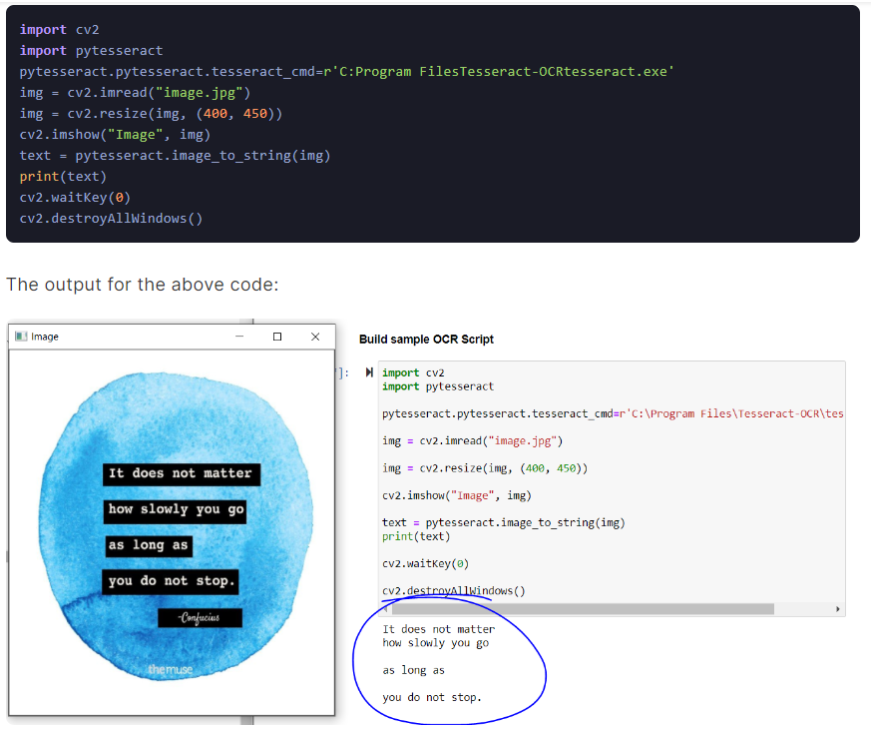
OCR
pip install easyocr==1.6.2
(OCR) is a technique to extract text from printed or scanned photos, handwritten text images and convert them into a digital format that can be editable and searchable.

Slide 18
Simple Shape Detection

Slide 19
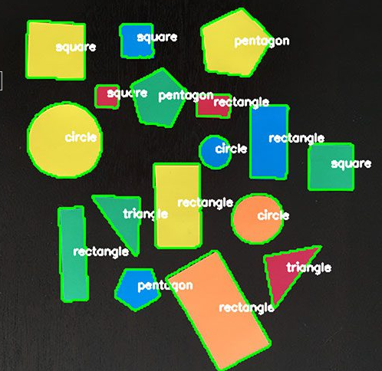
Simple Shape Detection

Slide 20

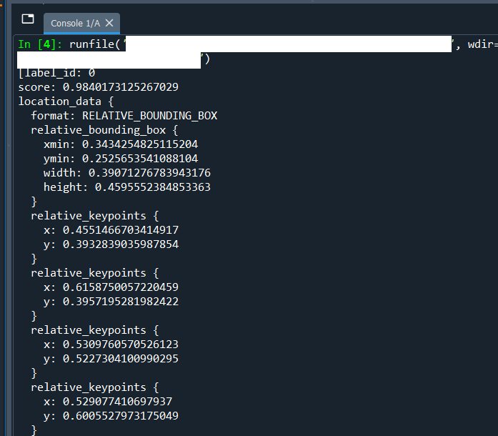
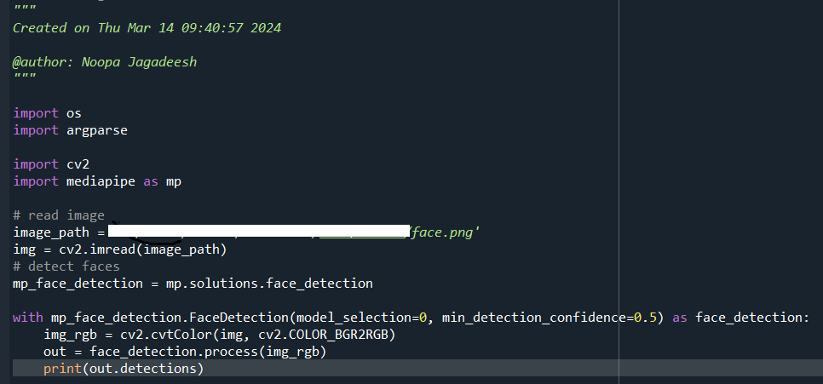
Face detection
pip install mediapipe==0.9.0
Notes:
opencv-python==4.6.0.66
mediapipe==0.9.0

Slide 21
Disclaimer
Due to nature of the course, various materials have compiled from different open source resources with some moderation. I sincerely acknowledge their hard work and contribution

Slide 22


